Slide 1
US National Reporting Platform: National Statistics for Global SDGs
Statistical and Science Policy Branch
U. S. Office of Management and Budget
Notes:
Good morning. We represent the Office of the US Chief Statistician. It is our great pleasure to speak with you today about how our office has approached the extensive reporting requirements associated with the Sustainable Development Goals. We will discuss our reflections on the reporting challenges, our thinking on developing a solution, and the progress we have made to date. We will also describe collaborations we have had with national statistical offices in other countries, and how we have worked together to identify and develop enhancements to this and similar platforms. Our NRP platform is open source, which means it is free to anyone. We want to share it and to learn from others how to enhance it. We hope if you may be interested in learning more that you will contact us.

Slide 2
Monitoring Progress of Agenda 2030
UN member countries have agreed to participate in achieving the Agenda over the next 15 years.
The Sustainable Development Goals span 17 broad goals. Across these, there are 169 targets.
Monitoring global progress in achieving the targets (and therefore goals) will be done through measurement of ~240 indicators.
This work continues to evolve (e.g., indicator refinements noted at UN Statistical Commission Meetings in March 2017)
Notes:
Agenda 2030 is ambitious. Its goals build upon and extend those of the Millennium Development Goals. The Sustainable Development Goals span twice the number of goals and are much broader in scope. The Agenda also calls upon all UN member countries to work toward achieving these goals. To monitor progress in achieving the goals, 169 targets were established and roughly 240 global indicators.

Slide 3
US NRP Web Links
Official site: <https://sdg.data.gov/>
https://sdg.data.gov
Staging site (for demo):
< https://gsa.github.io/sdg-indicators/ >
https://gsa.github.io/sdg-indicators/
Beta Spanish language site
< https://angela-smithers.github.io/sdg-indicators/ >
https://angela-smithers.github.io/sdg-indicators/
Notes:
Agenda 2030 is ambitious. Its goals build upon and extend those of the Millennium Development Goals. The Sustainable Development Goals span twice the number of goals and are much broader in scope. The Agenda also calls upon all UN member countries to work toward achieving these goals. To monitor progress in achieving the goals, 169 targets were established and roughly 240 global indicators.

Slide 4
Platform Purposes
To measure progress globally, (most) SDG indicators will rely on national statistics
In the US, (most of) these national statistics are produced by our Federal Statistical System; they are not modeled by other international organizations on our behalf
Notes:
The reporting challenge is substantial. Across several goal domains, measuring progress challenges all countries to build upon their existing statistical capacity to produce national statistics that are robust, transparent, and accessible to the public. In the US case, our highly decentralized statistical system (spanning 128 Federal statistical programs) is coordinated through the Office of the Chief Statistician in the Office of Management and Budget. Given the expected volume of reporting for the SDGs, we are challenged to develop more efficiencies and greater accessibility to meet stakeholders’ needs.

Slide 5
Concepts for a Platform
“Open Data”
Open source (free) technology
Publicly accessible; user friendly
“Many Hands”
Allow multiple providers, simultaneously, through secure access; track changes by user
“Same Team”
Facilitate use by other interested countries to reduce burden, promote interoperability and ease report preparation
Promote collaboration across national statistical offices as countries customize their own NRP (e.g., Spanish version)
Notes:
In the US context, we thought about what a technical solution might look like. First, we wanted to use open source technology, or “free ware” so that we would not need to expend resources on software costs. We also wanted to use programming language that could be used (with minimal assistance from data scientists) by everyday people—even national statisticians. It was also important that the resulting platform would be easily accessible to the public at large—so that any member of the public could access our national statistics, thereby reducing the volume of data requests and improving the transparency of national statistics.
Also, in the US context, it was important to develop a platform that would allow many data providers to contribute on a flow basis. Given the number of statistical programs that we have, and the number of datasets available with different publication schedules, it was essential that authorized access could be extended to many users.
Another key goal was to be able to share our platform with anyone—free of charge—for their own customization according to their own needs and interests, and to then encourage collaboration as others identify enhancements of mutual interest.

Slide 6
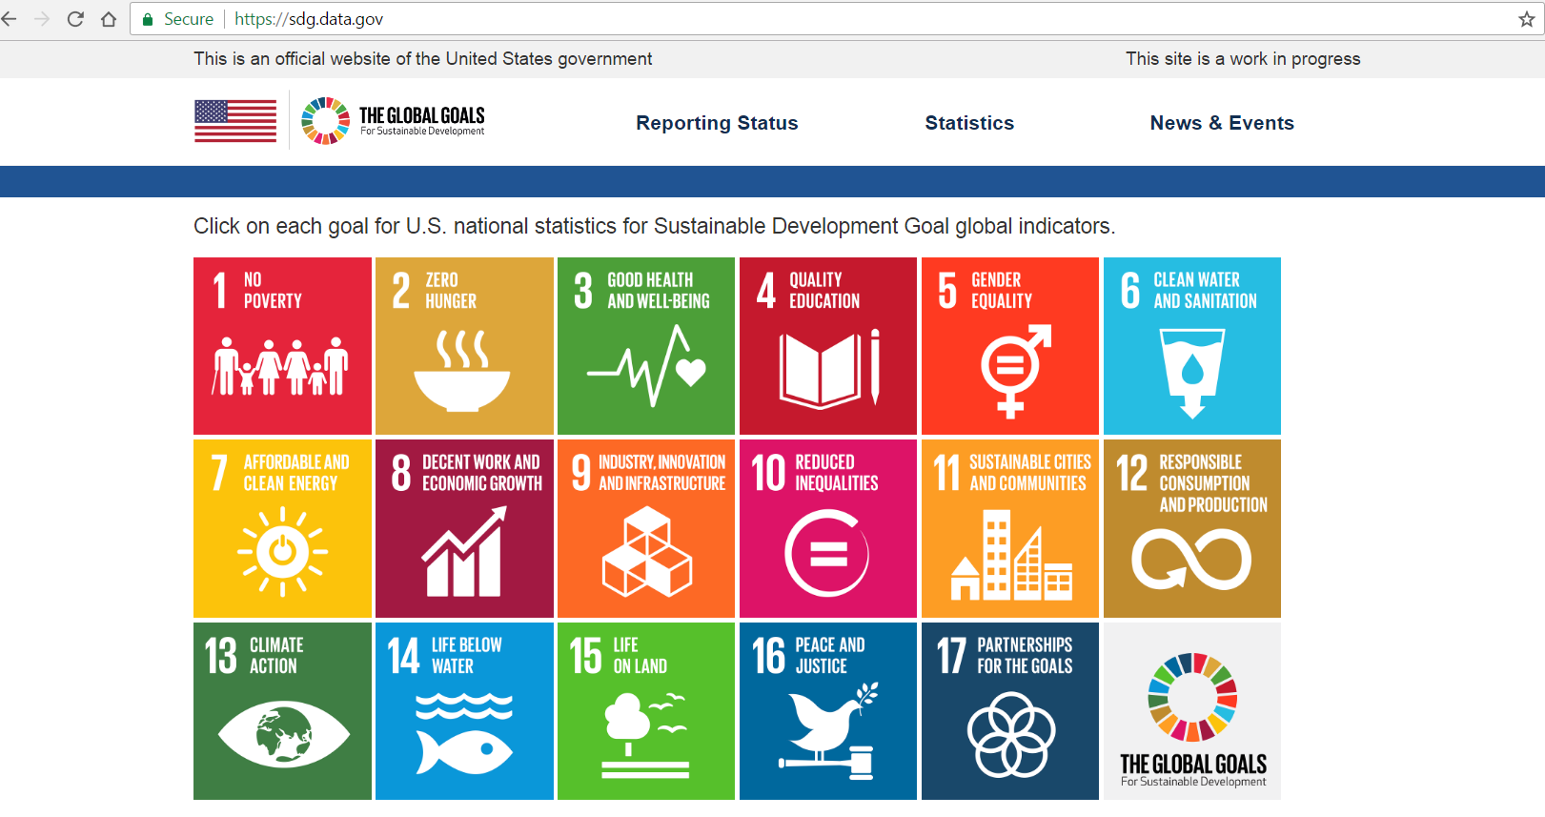
US National Reporting Platform
Notes:
The result is our US National Reporting Platform. It is an online tool through which authorized users can input national statistics and metadata, and, once verified, this information is then available to the public. Our first focus in developing the tool was to receive and display national statistics, so the functionalities currently in place were developed with data providers in mind. I will walk you through that functionality, and then share with you some ideas we have for further enhancements (in collaboration with other countries). You can find the official site at https://sdgs.data.gov. From this page, you would click on an SDG icon of interest.

Slide 7
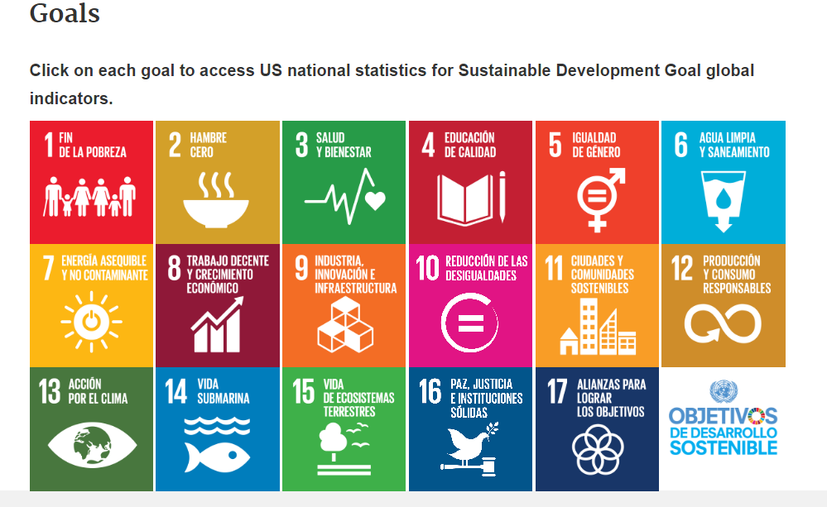
First Look in Spanish! Estadísticas Nacionales de USA para los Objetivos de Desarrollo Sostenible de la ONU
Notes:
The result is our US National Reporting Platform. It is an online tool through which authorized users can input national statistics and metadata, and, once verified, this information is then available to the public. Our first focus in developing the tool was to receive and display national statistics, so the functionalities currently in place were developed with data providers in mind. I will walk you through that functionality, and then share with you some ideas we have for further enhancements (in collaboration with other countries). You can find the official site at https://sdgs.data.gov. From this page, you would click on an SDG icon of interest.

Slide 8
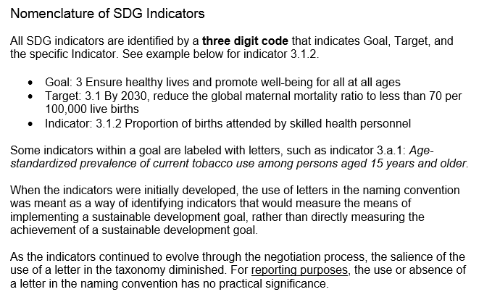
Notes:
After clicking on the icon corresponding to the SDG goal of interest (here, we clicked on SDG 3, health), you see the global indicators associated with that goal. Indicators that have been populated with national statistics appear in purple font. Agencies are able to provide statistics as they become available.

Slide 9
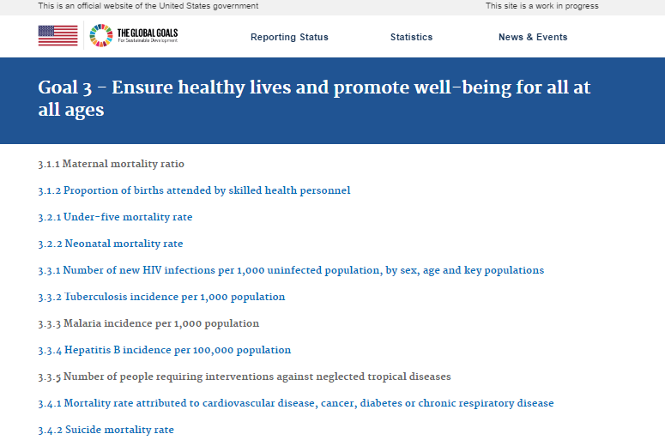
Indicators are populated on a flow basis
Notes:
After clicking on the icon corresponding to the SDG goal of interest (here, we clicked on SDG 3, health), you see the global indicators associated with that goal. Indicators that have been populated with national statistics appear in purple font. Agencies are able to provide statistics as they become available.

Slide 10
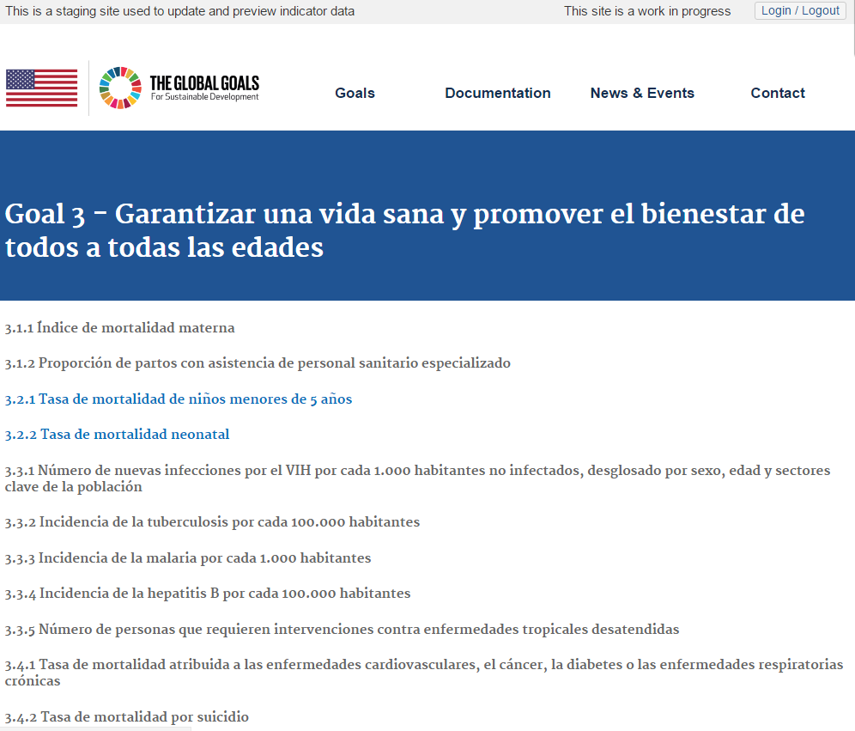
..and the Spanish version:
Notes:
After clicking on the icon corresponding to the SDG goal of interest (here, we clicked on SDG 3, health), you see the global indicators associated with that goal. Indicators that have been populated with national statistics appear in purple font. Agencies are able to provide statistics as they become available.

Slide 11
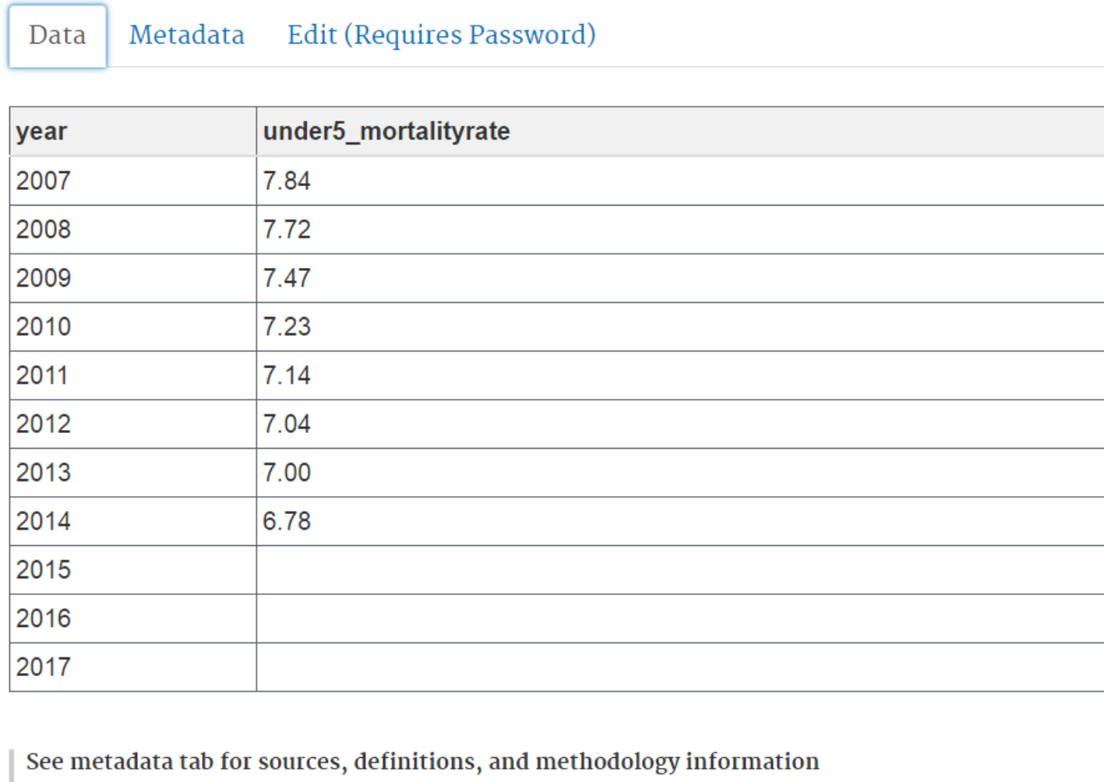
National statistics shown in tabular form
Notes:
After selecting an indicator of interest (here indicator 3.2.1), national statistics are shown in tabular form, which can be downloaded in CSV format. Using the staging site (shown here), data providers use this interface to key in statistics and metadata consistent with UN standard data and metadata exchange guidelines (to the extent possible) in machine readable form.

Slide 12
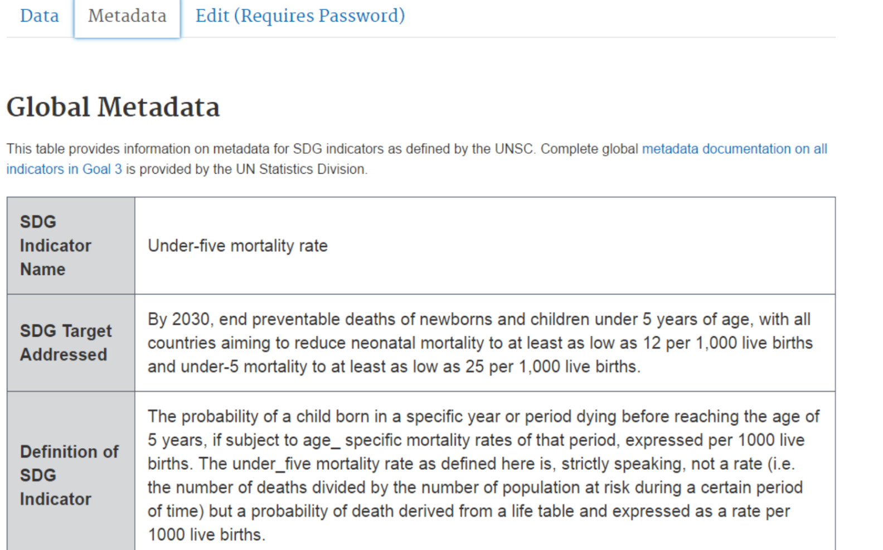
Global metadata provided
Notes:
I will skim over the next two slides, which describe the way we describe the data and statistics featured on the platform. Information about data—or “data about data” is called metadata. We feature two kinds of metadata on the site: global and national. For example, on the associated metadata tab in our platform at present, the global metadata provided by UN Statistical Division to date is featured. (In some cases, these global metadata are more robust than others.)

Slide 13
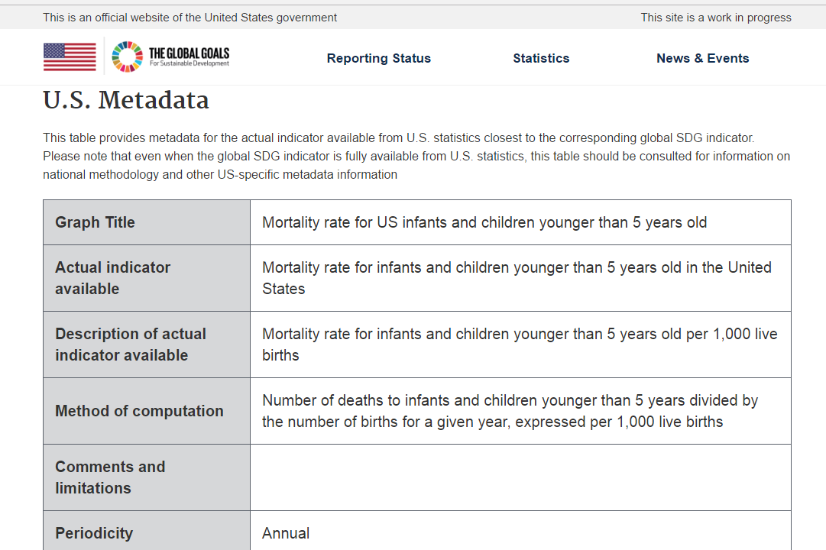
National metadata provided
Notes:
Below the global metadata, we feature US national metadata. Here, I am showing only the first few elements that are populated for this indicator. National metadata are important because oftentimes the global metadata are not fully clear or complete, and sometimes the US has national statistics that are very similar (but not exactly the same) as the global data would prescribe. (We call these “similar, but not exactly the same” indicators “proxy indicators,” which are intended to be temporary contributions as the official global indicators are further refined.)

Slide 14
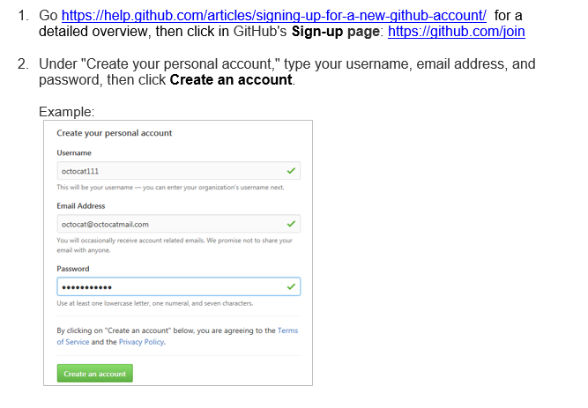
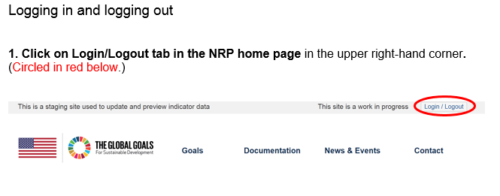
Under the hood/Bajo la capota: functionality for authorized data providers
Notes:
Below the global metadata, we feature US national metadata. Here, I am showing only the first few elements that are populated for this indicator. National metadata are important because oftentimes the global metadata are not fully clear or complete, and sometimes the US has national statistics that are very similar (but not exactly the same) as the global data would prescribe. (We call these “similar, but not exactly the same” indicators “proxy indicators,” which are intended to be temporary contributions as the official global indicators are further refined.)

Slide 15
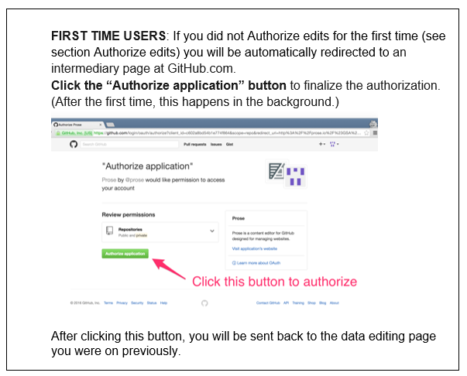
Under the hood/Bajo la capota: functionality for authorized data providers
Notes:
Below the global metadata, we feature US national metadata. Here, I am showing only the first few elements that are populated for this indicator. National metadata are important because oftentimes the global metadata are not fully clear or complete, and sometimes the US has national statistics that are very similar (but not exactly the same) as the global data would prescribe. (We call these “similar, but not exactly the same” indicators “proxy indicators,” which are intended to be temporary contributions as the official global indicators are further refined.)

Slide 16
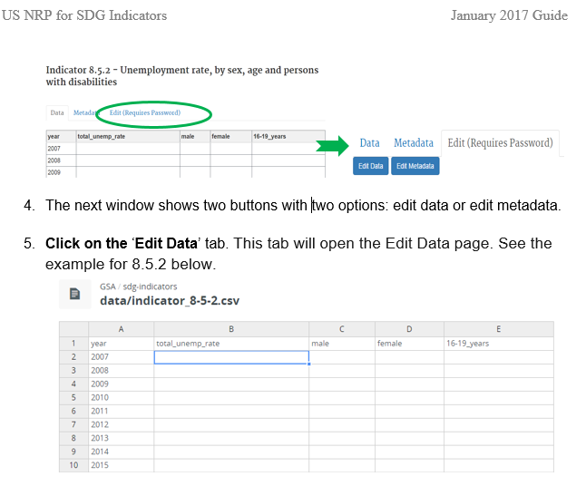
NRP Data entry
Notes:
Below the global metadata, we feature US national metadata. Here, I am showing only the first few elements that are populated for this indicator. National metadata are important because oftentimes the global metadata are not fully clear or complete, and sometimes the US has national statistics that are very similar (but not exactly the same) as the global data would prescribe. (We call these “similar, but not exactly the same” indicators “proxy indicators,” which are intended to be temporary contributions as the official global indicators are further refined.)

Slide 17
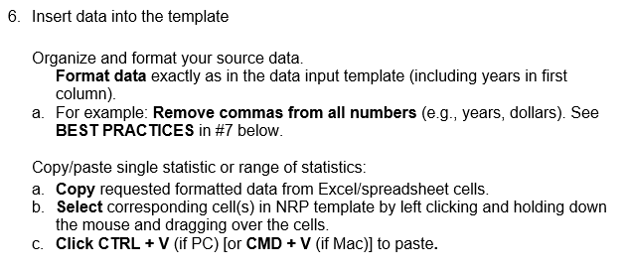
Detailed reference/training manual tips
Notes:
Below the global metadata, we feature US national metadata. Here, I am showing only the first few elements that are populated for this indicator. National metadata are important because oftentimes the global metadata are not fully clear or complete, and sometimes the US has national statistics that are very similar (but not exactly the same) as the global data would prescribe. (We call these “similar, but not exactly the same” indicators “proxy indicators,” which are intended to be temporary contributions as the official global indicators are further refined.)

Slide 18
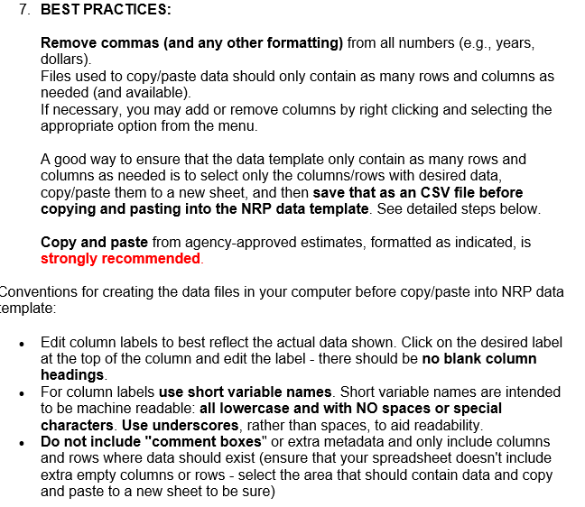
Detailed reference/training manual tips
Notes:
Below the global metadata, we feature US national metadata. Here, I am showing only the first few elements that are populated for this indicator. National metadata are important because oftentimes the global metadata are not fully clear or complete, and sometimes the US has national statistics that are very similar (but not exactly the same) as the global data would prescribe. (We call these “similar, but not exactly the same” indicators “proxy indicators,” which are intended to be temporary contributions as the official global indicators are further refined.)

Slide 19
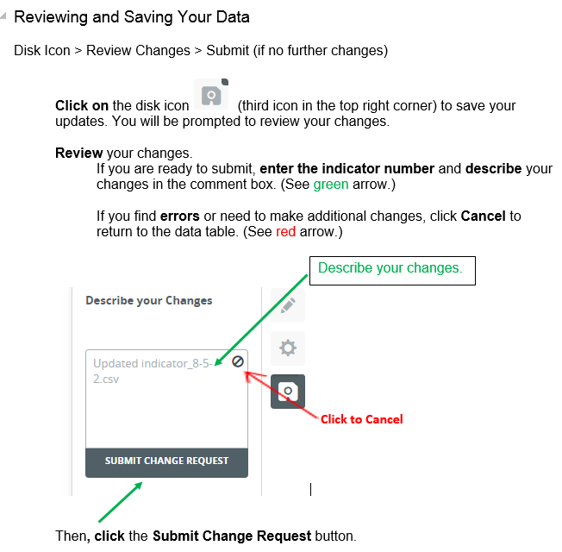
Notes:
Below the global metadata, we feature US national metadata. Here, I am showing only the first few elements that are populated for this indicator. National metadata are important because oftentimes the global metadata are not fully clear or complete, and sometimes the US has national statistics that are very similar (but not exactly the same) as the global data would prescribe. (We call these “similar, but not exactly the same” indicators “proxy indicators,” which are intended to be temporary contributions as the official global indicators are further refined.)

Slide 20
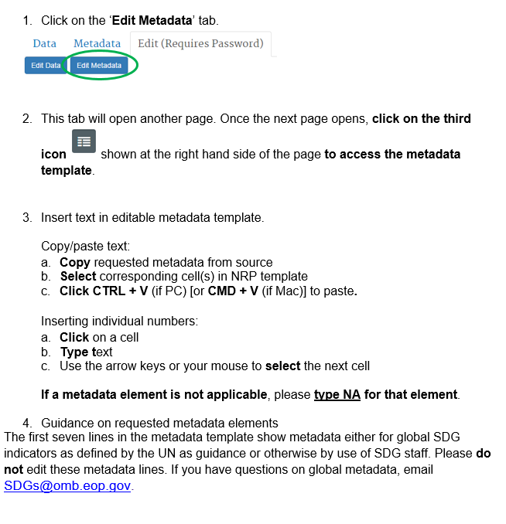
NRP Metadata entry
Notes:
Below the global metadata, we feature US national metadata. Here, I am showing only the first few elements that are populated for this indicator. National metadata are important because oftentimes the global metadata are not fully clear or complete, and sometimes the US has national statistics that are very similar (but not exactly the same) as the global data would prescribe. (We call these “similar, but not exactly the same” indicators “proxy indicators,” which are intended to be temporary contributions as the official global indicators are further refined.)

Slide 21
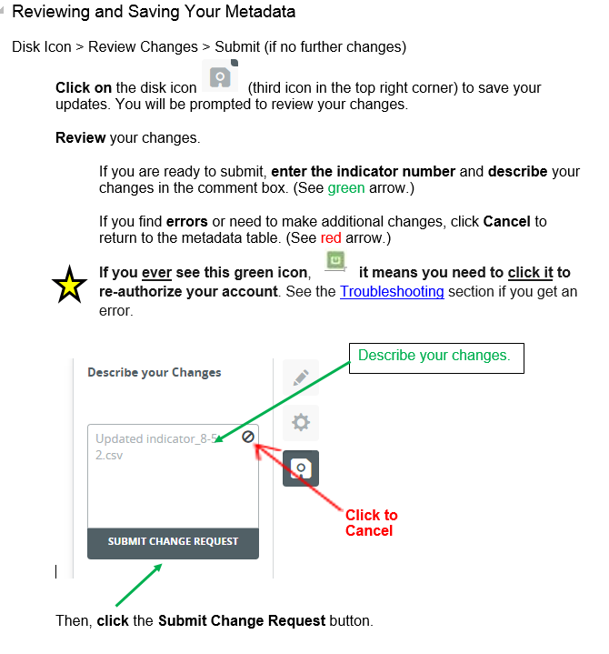
NRP Metadata entry
Notes:
Below the global metadata, we feature US national metadata. Here, I am showing only the first few elements that are populated for this indicator. National metadata are important because oftentimes the global metadata are not fully clear or complete, and sometimes the US has national statistics that are very similar (but not exactly the same) as the global data would prescribe. (We call these “similar, but not exactly the same” indicators “proxy indicators,” which are intended to be temporary contributions as the official global indicators are further refined.)

Slide 22
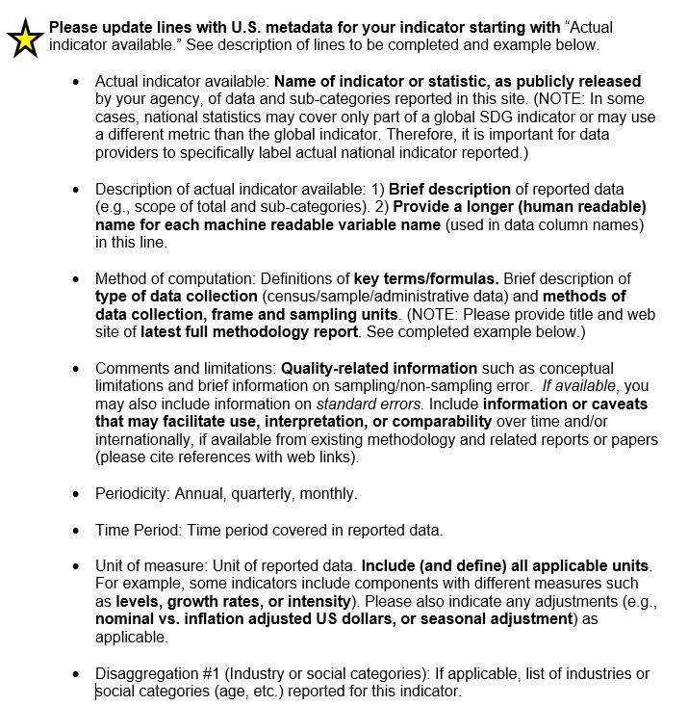
NRP Metadata entry
Notes:
Below the global metadata, we feature US national metadata. Here, I am showing only the first few elements that are populated for this indicator. National metadata are important because oftentimes the global metadata are not fully clear or complete, and sometimes the US has national statistics that are very similar (but not exactly the same) as the global data would prescribe. (We call these “similar, but not exactly the same” indicators “proxy indicators,” which are intended to be temporary contributions as the official global indicators are further refined.)

Slide 23
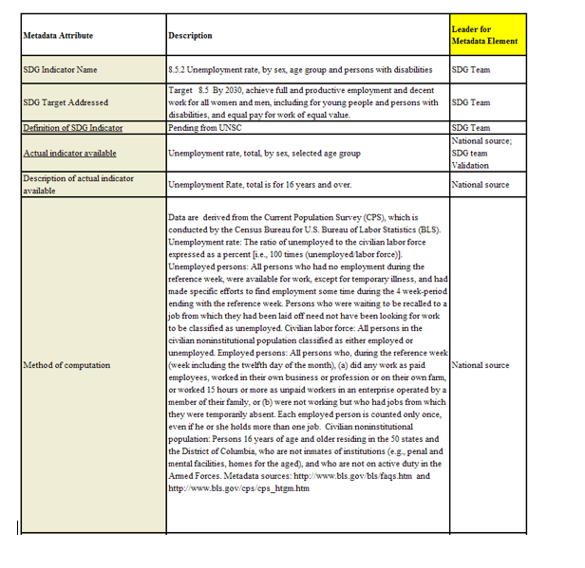
NRP Metadata entry
Notes:
Below the global metadata, we feature US national metadata. Here, I am showing only the first few elements that are populated for this indicator. National metadata are important because oftentimes the global metadata are not fully clear or complete, and sometimes the US has national statistics that are very similar (but not exactly the same) as the global data would prescribe. (We call these “similar, but not exactly the same” indicators “proxy indicators,” which are intended to be temporary contributions as the official global indicators are further refined.)

Slide 24
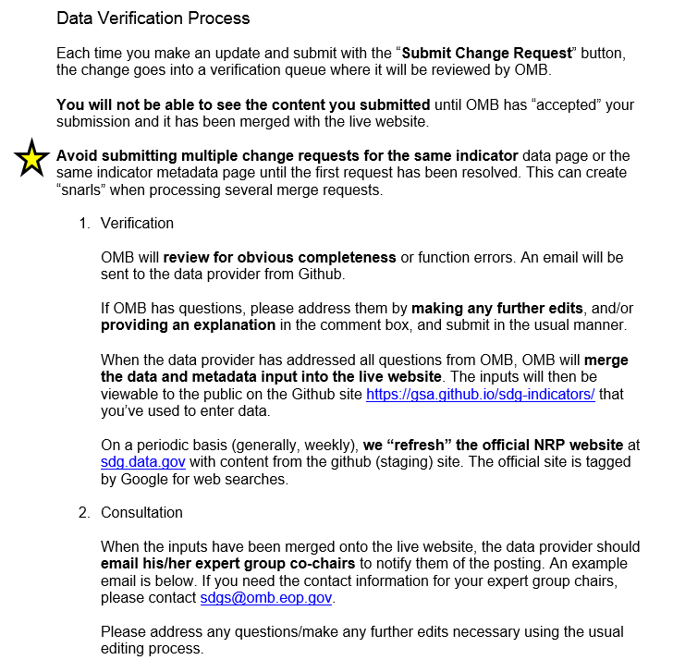
Notes:
Below the global metadata, we feature US national metadata. Here, I am showing only the first few elements that are populated for this indicator. National metadata are important because oftentimes the global metadata are not fully clear or complete, and sometimes the US has national statistics that are very similar (but not exactly the same) as the global data would prescribe. (We call these “similar, but not exactly the same” indicators “proxy indicators,” which are intended to be temporary contributions as the official global indicators are further refined.)

Slide 25
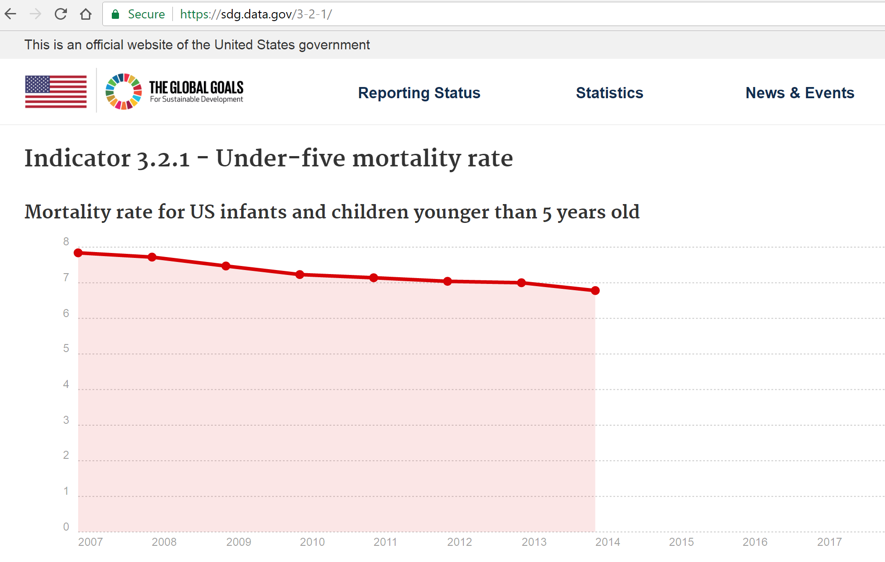
National statistics shown in graph form
Notes:
When the indicator has been populated by the data provider and verified by our office, a graph is also produced. These features “turn on” automatically when the metadata are complete. Therefore, the updates require little additional work. Here is a graph for indicator 3.2.1.

Slide 26
Other enhancements underway
Improve utility for policy makers
provide dashboard for monitoring overall reporting status
provide disaggregation feature for graphs (UK)
more clearly indicate tiering and proxy indicators
Improve accessibility for lay public
ensure accessibility for persons with special needs
filter tool to find quickly a given indicator(s) related to a subject
FAQ to post on official site for data users
Improve functionality for data providers
provide a data dictionary
communication tool to match data holders with NSOs
Improve capacity/collaboration across countries
provide “how to” guidance for forking by other country NSOs (UK)
translation feature (for use with initial forking, for example)
Notes:
We continue to work on this platform in collaboration with other countries. To date, this collaboration has been primarily with UN Economic Commission for Europe Conference of European Statistician countries, including our colleagues in Mexico and Canada. And we are very pleased to say that our colleagues in the UK were able to clone our platform and customize it for their own needs. We are now working with them as each of our groups develops enhancements that can be easily shared. Here is a list of enhancements that are underway. You can see that the UK is currently working on improved graphing features using the same software that can be “plugged in” to the US site. They are also kind enough to develop a guide to cloning or “forking” the site for other countries to use. This is a nice addition to our data provider training guide and webinar now available on our staging site. It’s a great way to collaborate across countries.

Slide 27
Contact information
<Jennifer_E_Park@omb.eop.gov>
<Francisco_A_Moris@omb.eop.gov> <fmoris@nsf.gov>
Appendix

Slide 28
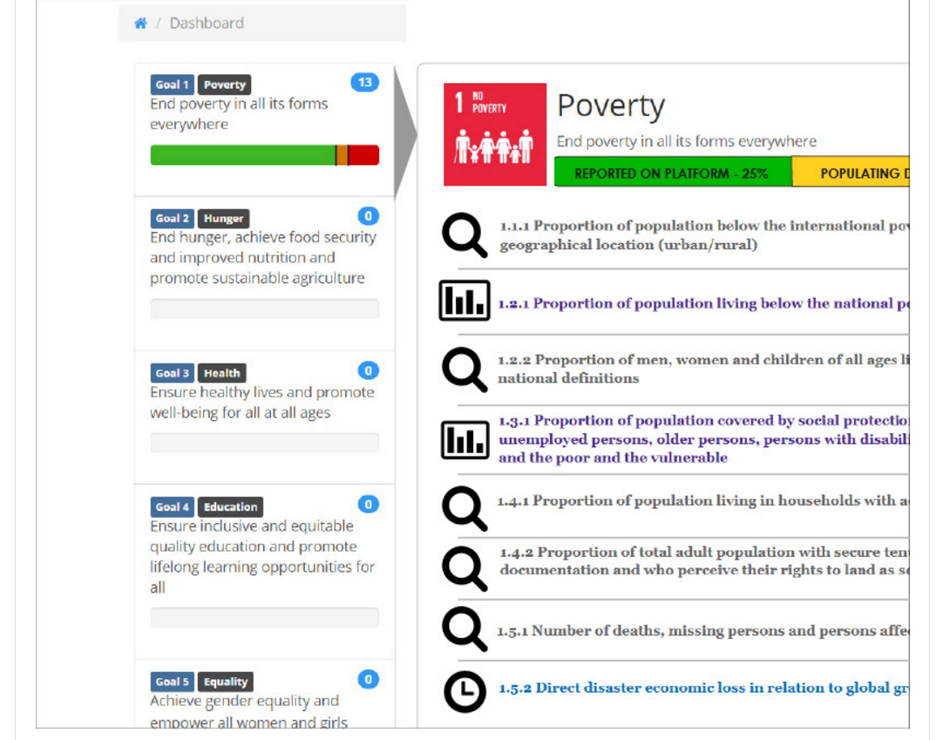
Dashboard Concept: Dynamic Update
Notes:
We would like to communicate this reporting status with the public to convey where work has been done, where work is continuing, and where gaps have been identified. We are currently working on a dashboard feature to integrate into the existing platform. Here is an early prototype. The “thermometer” on the left shows the reporting status by goal. IT DOES NOT show U.S. progress on the goal. Here, SDG 1 and its indicators are shown. A magnifying glass indicates we are looking for suitable data sources. Graphs indicate that statistics have been populated. A clock indicates that we have found the relevant data and are producing statistics.
This dashboard would be driven by the metadata and therefore automatically updated as additional indicators are worked and more statistics are reported. We can then share it with anyone using the free platform as an enhancement.

Slide 29
U.S. Indicator Reporting Status
Almost all Tier 1 and 2 indicators are now reported or assigned to a confirmed point of contact.
Notes:
At the time, the US has used the NRP to report about 37% of the SDG indicators. We may be able to report on a few more in the next year or so, but for the most part, more conceptual and methodological work will need to be done on the remaining indicators before the US will be able to begin reporting on them. We understand this assessment is common in Canada and the UK as well.

Slide 30
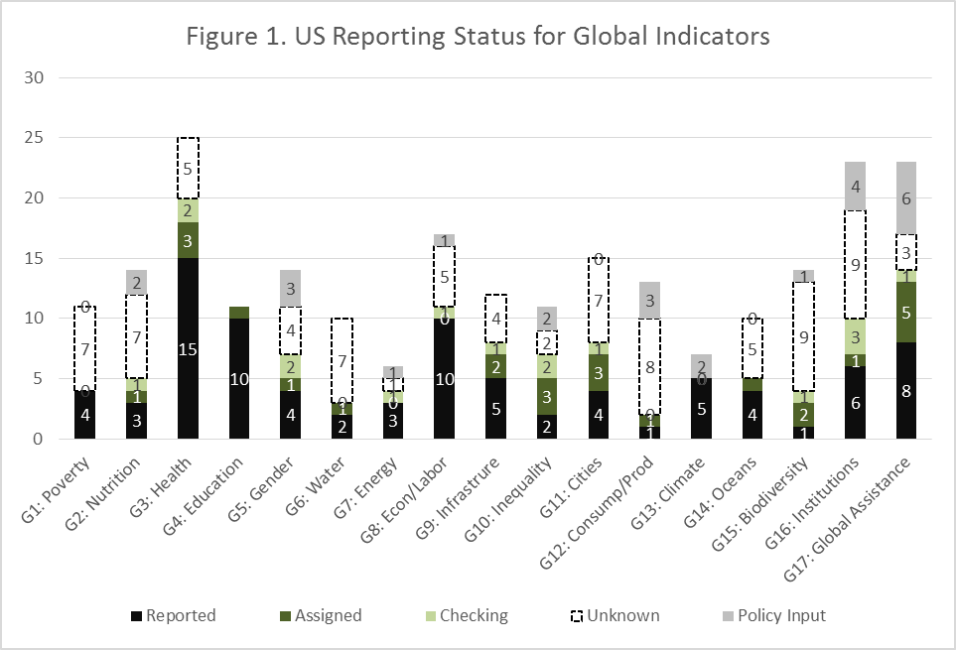
Availability of Federal Statistics, by Goal February 2017
Notes:
Of course, our ability to report varies quite a bit by goal. As you can see from this graph, reporting is more complete in some goals pertaining to areas where statistics are more traditionally produced. To address these data gaps, we will actively explore nontraditional data sources. We will ask the Global Partnership for Sustainable Development Data for their assistance in this.

